Slide 1
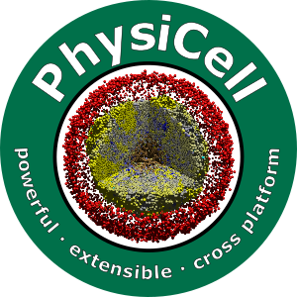


Lesson 3: What is an agent-based model?
Slides, videos, links and more:
https://github.com/physicell-training/03-What-is-ABM
Paul Macklin, Ph.D.
@MathCancer
last updated: February 11, 2020

Slide 2
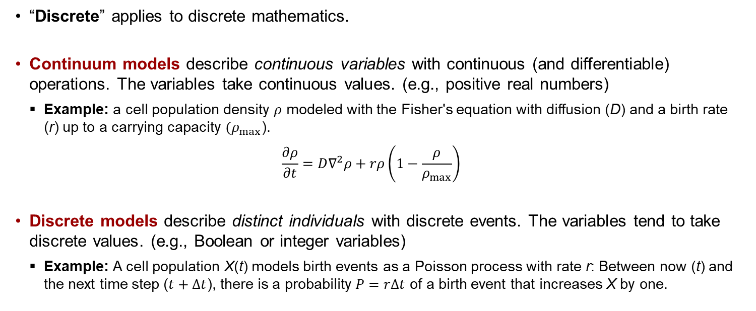
What is a discrete model?
“Discrete” applies to discrete mathematics.
Continuum models describe continuous variables with continuous (and differentiable) operations. The variables take continuous values. (e.g., positive real numbers)
Example: a cell population density $ρ$ modeled with the Fisher's equation with diffusion (D) and a birth rate (r) up to a carrying capacity $(ρ_{max}$).
$$\frac{∂ρ}{∂t}=D∇^{2}ρ+rρ\left(1−\frac{ρ}{ρ_{max}}\right)$$
Discrete models describe distinct individuals with discrete events. The variables tend to take discrete values. (e.g., Boolean or integer variables)
Example: A cell population X(t) models birth events as a Poisson process with rate r: Between now (t) and the next time step ($t+Δt$), there is a probability $P=rΔt$ of a birth event that increases X by one.

Slide 3
What is an agent-based model?
An agent-based model (in biology) is a type of discrete model that simulates individual cells.
Also referred to as individual-based models or cell-based models.
Agent-based models are often combined with continuum models of the microenvironment (e.g., partial differential equations for signaling factors), resulting in hybrid discrete-continuum (HDC) models.
Object-oriented programming (OOP) is ideal for agent-based modeling:
Modeling work focuses on individual cells
Each cell is an independent agent that carries its own data, and has its own behavioral rules
Use OOP: Define a cell class with member data and methods. Each cell is an instance of that class.
Agent-based models are a little closer to the biology:
Focus on modeling cells and their changing behavior.
Specific problems are then a matter of choosing the right rules.
You can tailor the level of detail: add molecular-scale biology to each cell if you need it.

Slide 4
Agent models are
Each cell is treated as a separate software object (an agent)
Internal data (an internal state)
Position, Size, Cycle State, molecular variables, ….
Cellular processes
Cycling, Death, Motility, Growth, Adhesion, …
Virtual cells move a simulated virtual (micro)environment
Generally liquid (e.g., water or interstitial fluid)
Chemical movement (oxygen, glucose, signaling factors)
Typically diffusion -- solve partial differential equations (PDEs)
May also require advection for environments with flow
May include mechanical structures like extracellular matrix (ECM)
Finite element methods or related methods

Slide 5
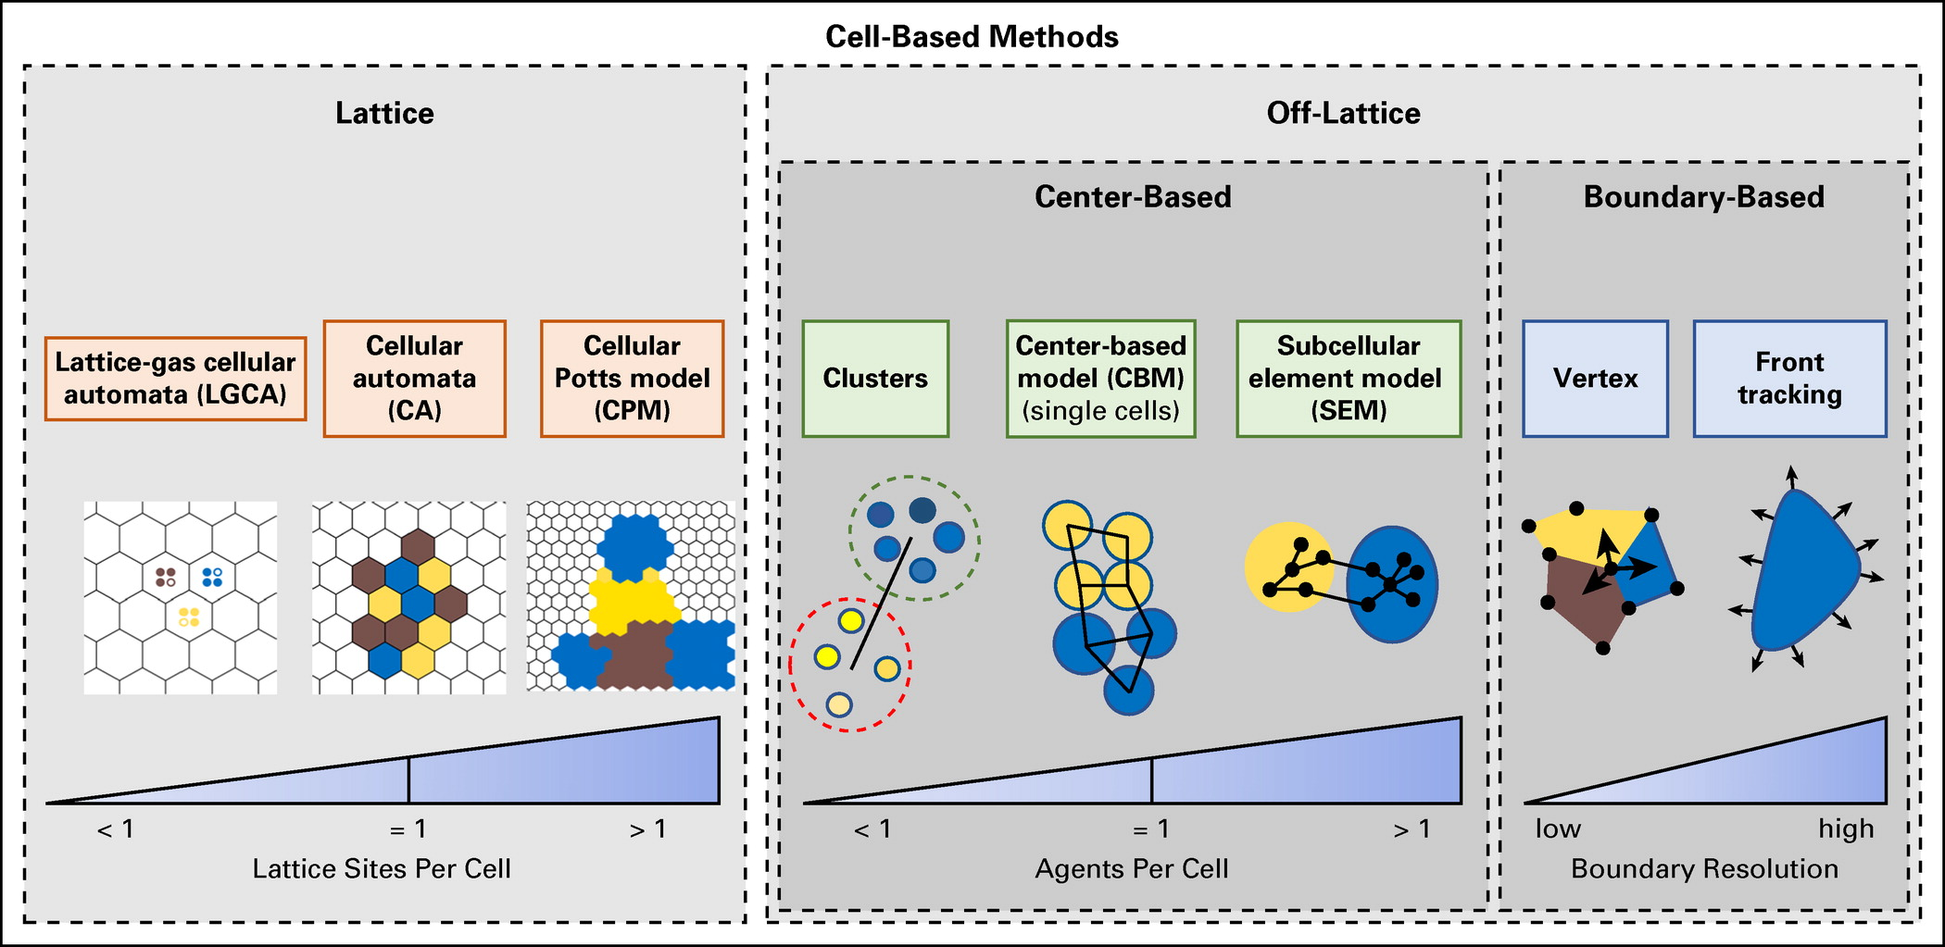
Main approaches
Approaches can be classified as lattice or off-lattice, and by resolution.
Review: Metzcar et al. (2019). http://dx.doi.org/10.1200/CCI.18.00069

Slide 6
Typical program flow
Read parameters
Set up microenvironment
Create meshes, initialize chemical substrates, diffusion solvers, etc.
Set up cell agents
Define all cell types
Instantiate cells
For each time:
Update microenvironment
Solve reaction-diffusion equations (as needed)
Solve tissue mechanics (as needed)
Update each cell's state
Sample environment
Run signaling model (as needed)
Update behavioral parameters based on signaling model and sampled environment
Run cell process models (growth, cycling, death, …)
Calculate cell velocities
Update cell positions
Advance time

Slide 7
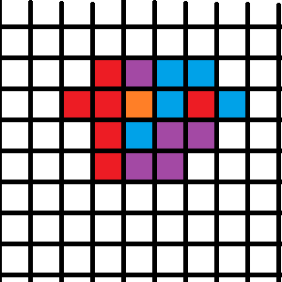
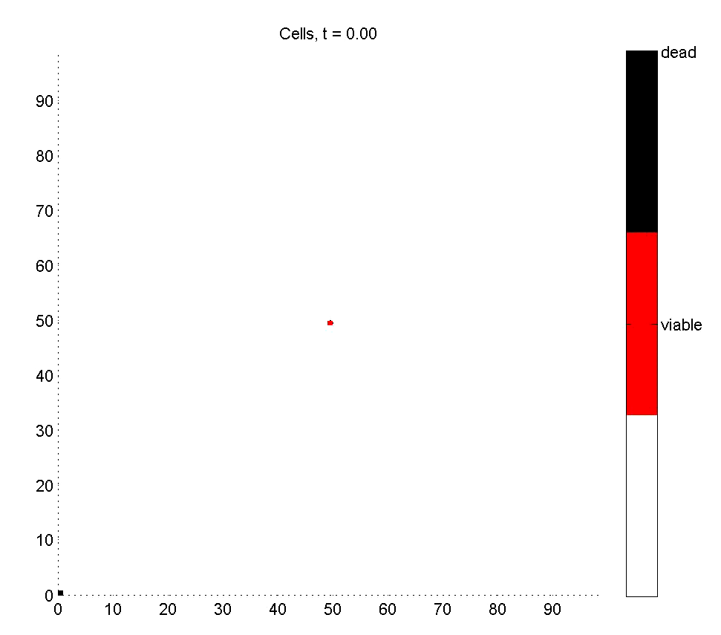
Cellular Automata
Approach:
Divide space into a lattice
Spatial resolution: Each lattice site holds 0 or 1 cell
Update each lattice site based on rules
Pros:
Easy to program
Very, very fast
Easy to swap in new hypotheses
Cons:
Lattice effects (& hidden assumptions)
All cells are the same size
No tissue mechanics
Update order biases
Usually solved with Monte Carlo (random update ordering)
Ideal use case:
Early qualitative tests of hypotheses

Slide 8
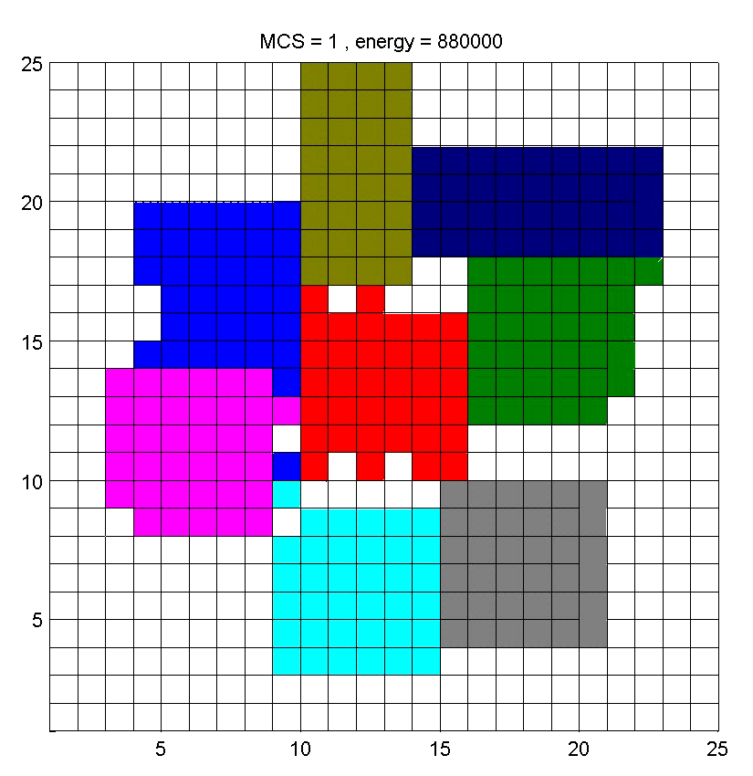
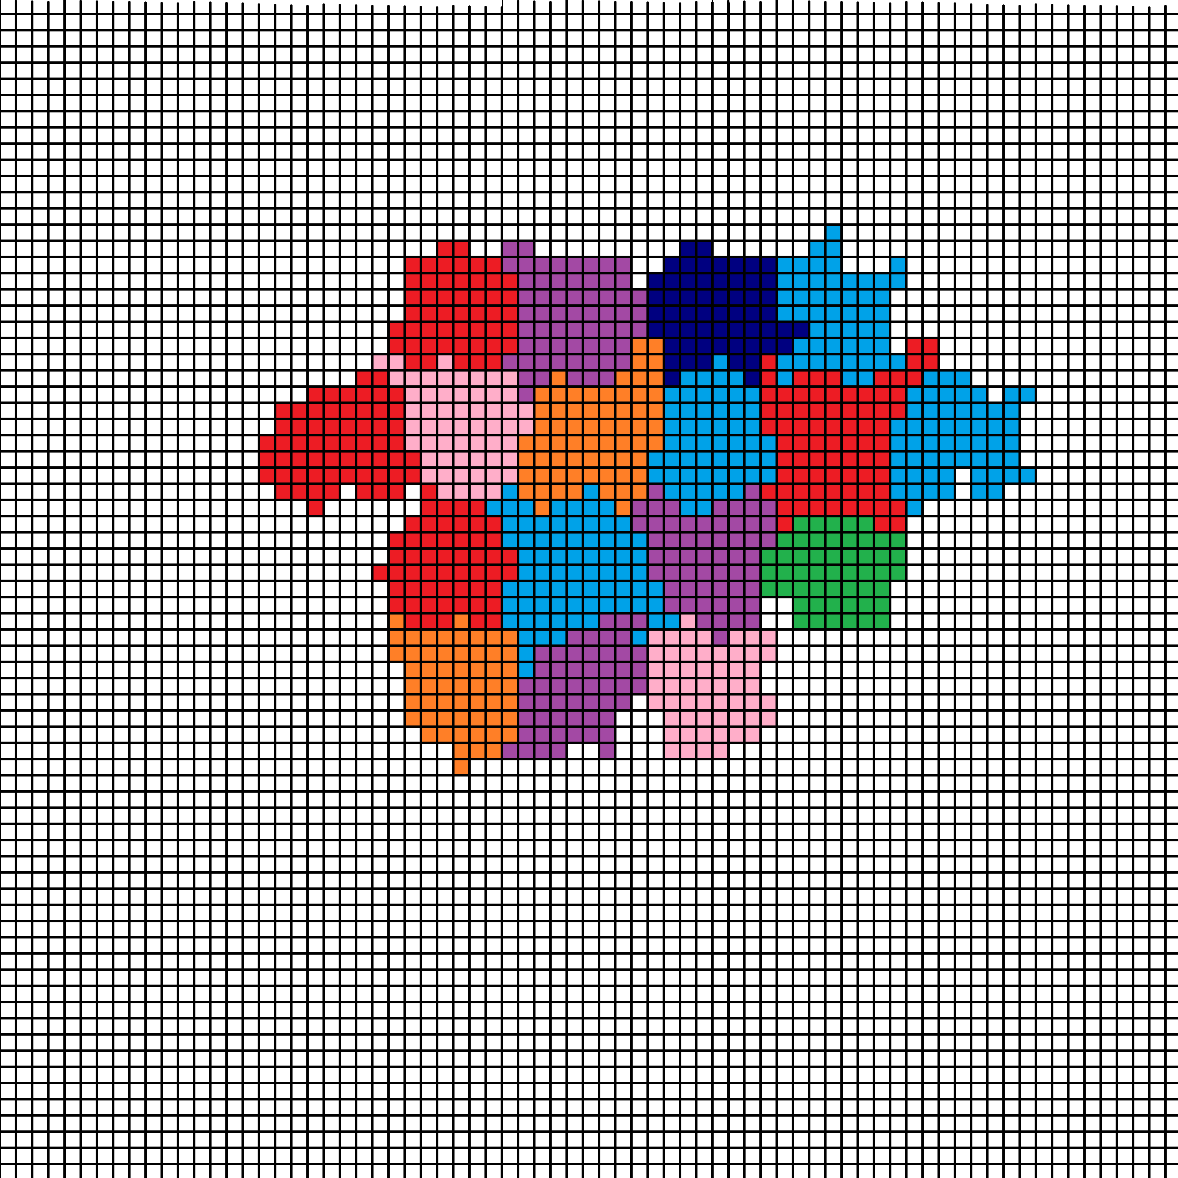
Cellular Potts
Approach:
Use a smaller mesh to resolve cell morphology
Spatial resolution: multiple pixels (or voxels) per cell
Minimize a specially-chosen energy
Randomly try to swap pixels
Accept if energy is lower
Pros:
Now we get cell shape and size
More realistic
Mature codes such as CompuCell3D and Morpheus
Cons:
No true time: Monte Carlo steps and “temperature”
Have to translate biology into energy
Unexpected correlations can pop up from the global energy
Needs expert coding to be fast
Ideal use case:
Qualitative tests of hypotheses where mechanics matter

Slide 9
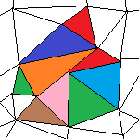
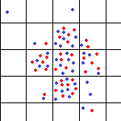
Other lattice-based approaches
Cellular automata on irregular meshes
Use an irregular mesh
Gets rid of grid bias issues
But still no control over individual cell sizes
Still no mechanics
Spatial resolution: One pixel (voxel) per cell
Lattice-gas
Treat space as a series of connected boxes
Each box contains one or more cells
Pre-defined “channels” for cell movement between boxes
A nice bridge towards continuum models
Spatial resolution: < 1 pixel (voxel) per cell

Slide 10
Key off-lattice approaches
Vertex-based models:
Densely packed cells look like polyhedral
Model the movement of the vertices, instead of the cells
Spatial resolution: 1 polyhedron per cell, approximating morphology
Center-based models:
Model movement of cell centers
Write force balance laws for each cell (classic physics!)
Update cell velocities and positions based on forces
Append extra biology to each cell as needed
Spatial resolution: 1 agent per cell
Subcellular element models:
Model movement of cell parts with individual agents (subcellular elements)
Write force balance laws for each part (classic physics!)
Update agent velocities and positions based on forces
Model cell growth, cycling, death, etc. with additional operations:
grow, divide, shrink, fuse, and eliminate subcellular elements
Spatial resolution: multiple agents per cell to approximate morphology

Slide 11
Where does PhysiCell fit in?
PhysiCell is an off-lattice, center-based modeling platform
Spatial resolution: one agent per cell
A trick: Use bigger agents to model cell collections or pieces of tissue.
PhysiCell couples with PDE models of the microenvironment, making it a hybrid discrete-continuum approach.
Since most useful agent-based models are coupled to PDE models of the microenvironment, we simply refer to them as agent-based models.
PhysiCell uses ODEs and other technical to model dynamical details in individual cells. This makes it multiscale.

Slide 12
Next steps
Super fast: Please proceed to 4 (Introduction to PhysiCell) link: https://github.com/physicell-training/04-PhysiCell-intro
Intermediate: Please proceed to 4 (Introduction to PhysiCell) link: https://github.com/physicell-training/04-PhysiCell-intro
Full training: Please proceed to 4 (Introduction to PhysiCell) link: https://github.com/physicell-training/04-PhysiCell-intro
More materials: https://github.com/physicell-training/master-list

Slide 13




Credits
Lesson Planning: Paul Macklin
Slides: Paul Macklin
Recording: Paul Macklin
Post-production: Paul Macklin, Drew Willis*, Kali Konstantinopoulos*
Microapps: Not applicable
* denotes undergraduate researcher
Funding:
PhysiCell Development:
Breast Cancer Research Foundation
Jayne Koskinas Ted Giovanis Foundation for Health and Policy
National Cancer Institute (U01CA232137)
National Science Foundation (1720625)
Training materials:
* Administrative supplement to NCI U01CA232137 (Year 2)

